Slide 1
1.ISHIMWE Kevin
2.NTEZIMANA Jean Claude
3.RWAGATARE Djafari
4.NIYIGENA Alanthese

Slide 2
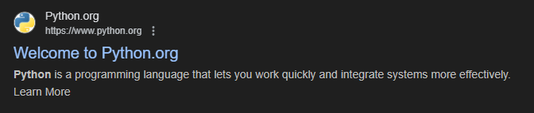
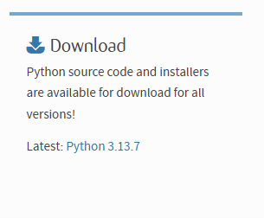
PREPARATION OF PYTHON
ENVIRONMENT
STEP1:Go to the browser and then search Python
STEP2:After click on this link
STEP3:Then you see the download button the click on it.

Slide 3
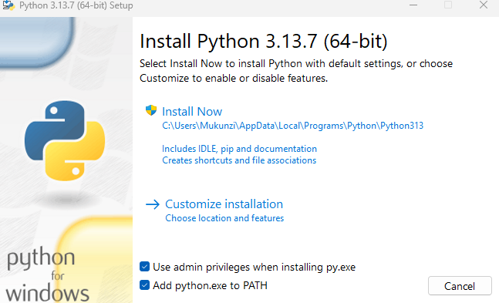
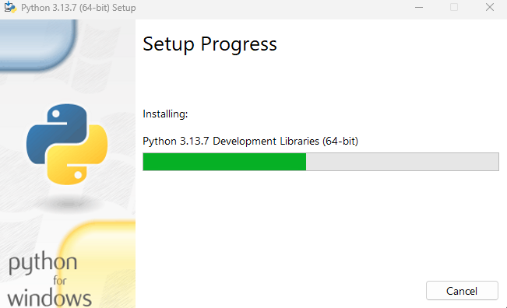
STEP4:After download completed show your setup in folder then Run as administrator then installation starts by enabling the following path . After enabling path click install now button.

Slide 4
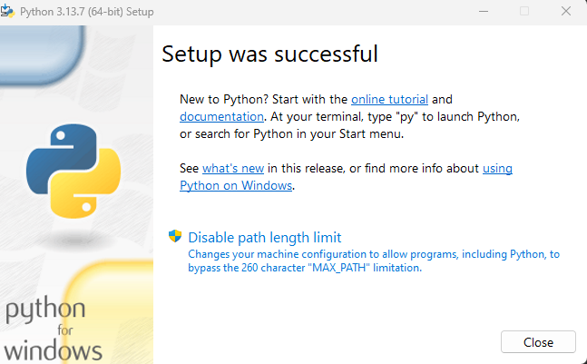
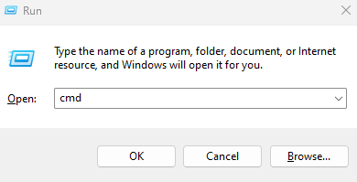
STEP5:Then after installation finished click close button
STEP6:At this step Python is already installed in your laptop after installation finished we have to check
If our python is installed properly by clicking win + R and then write CMD.

Slide 5
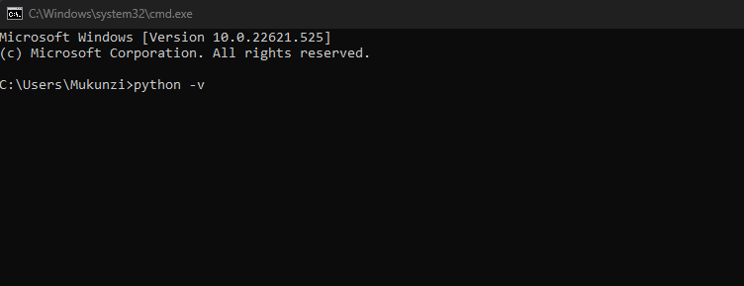
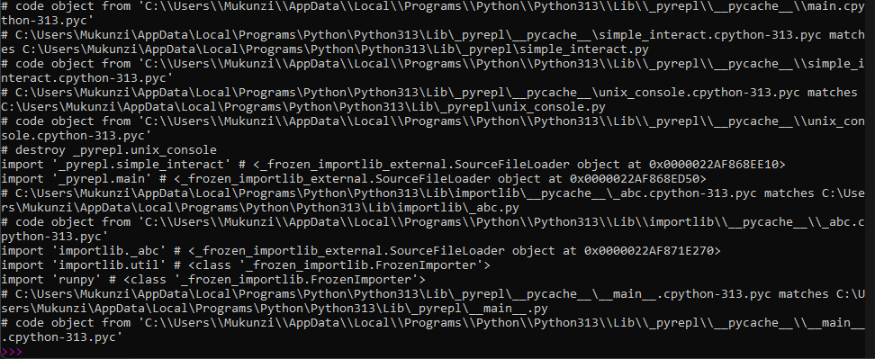
STEP7:Write this command in CMD in order to check if it is correctly installed
Python –v when you write this command and press it show his directories.

Slide 6
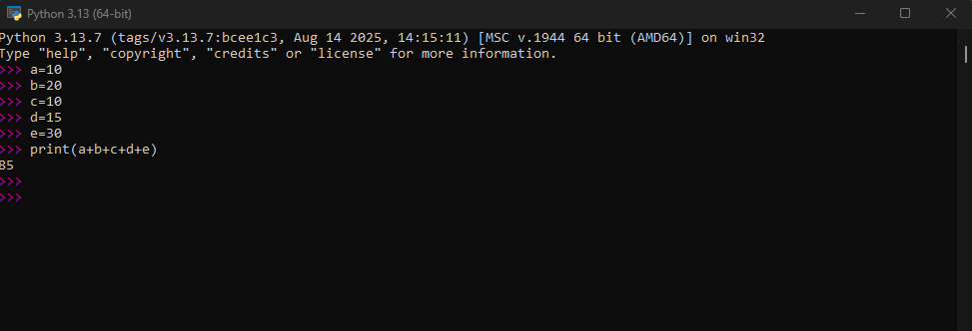
STEP8:After this completed successful you can start to write your program in your python IDE
For example :I am going to write program that will add 5 numbers
a=10
b=20
c=10
d=15
e=30

Slide 7
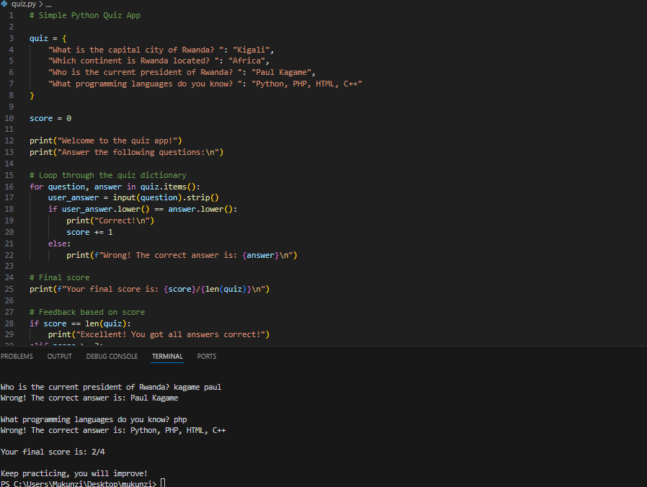
STEP9: It is not only this program you can also write program with Visual Studio Code by adding
Python extension and then you can start to create python program using visual studio code (VS CODE).

